Slide 1
DISSOCIATIVE DISORDERS
Dr. Pedro Hernandez Mandado
Consultant Psychiatrist
Consultant Professor
Master in Sciences

Slide 2
DEFINITION
Dissociation is the fragmentation or separation of aspects of consciousness, including memory, identity and perception. Some degree of dissociation is always present; however, if an individual’s consciousness becomes too fragmented, it may pathologically interfere with the sense of self and ability to adapt. Presenting complaints and findings of dissociative disorders include amnesia, personality change, erratic behavior, odd inner experiences (e.g./ flashbacks, déjà vu), and confusion

Slide 3
Dissociative disorders are also defined by a loss of memory (amnesia), identity, or sense of self (The normal integration of thoughts, behaviours, perceptions, feelings, and memory into a unique identity)

Slide 4
CAUSES
Most mental health professionals believe that the underlying cause of dissociative disorders is chronic trauma in childhood. Examples of trauma include repeated physical or sexual abuse, emotional abuse or neglect.
Unpredictable or frightening family environments may also cause the child to ‘disconnect’ from reality during times of stress.

Slide 5
It seems that the severity of the dissociative disorder in adulthood is directly related to the severity of the childhood trauma.
Traumatic events that occur during adulthood may also cause dissociative disorders. Such events may include war, torture or going through a natural disaster.

Slide 6
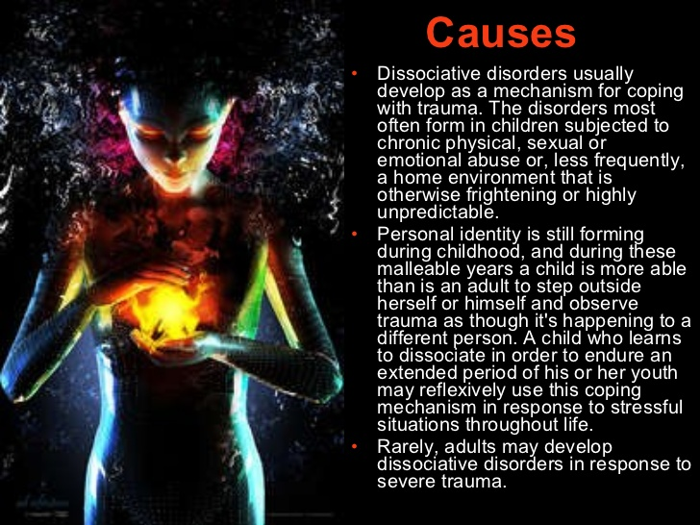

Slide 7
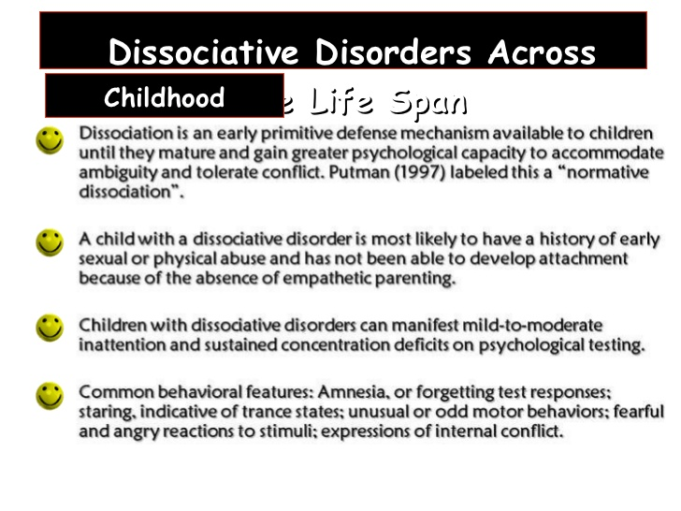

Slide 8
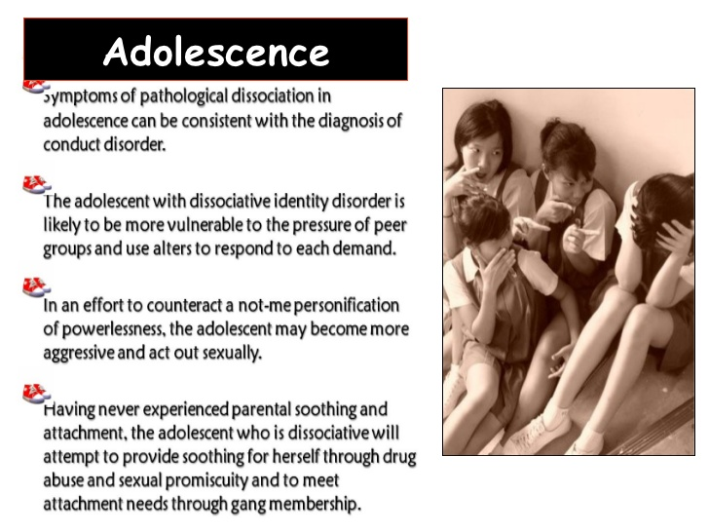

Slide 9
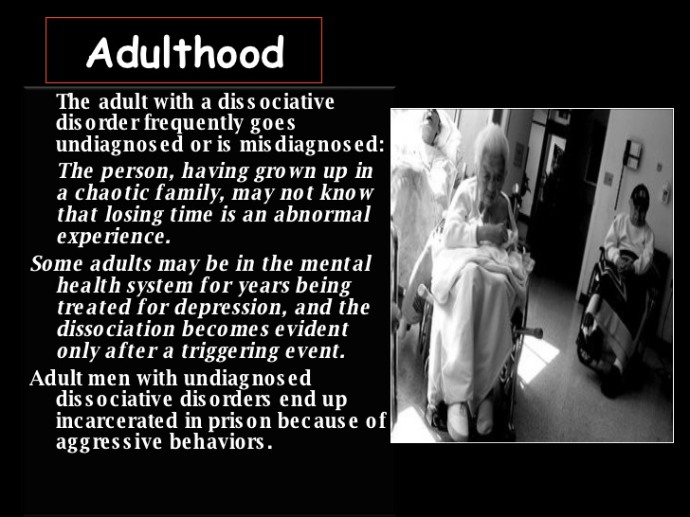

Slide 10
TYPES OF DISSOCIATIVE DISORDERS
Dissociative amnesia
Dissociative fugue
Depersonalization disorder
Dissociative identity disorder (MPD)
Dissociative ddisorder not otherwise specified

Slide 11
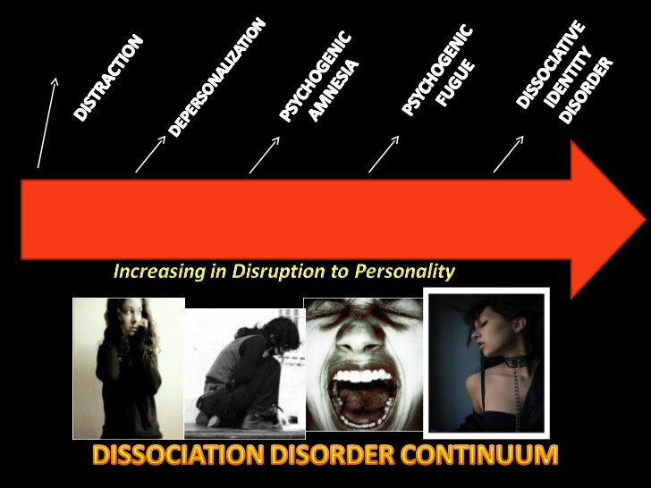

Slide 12
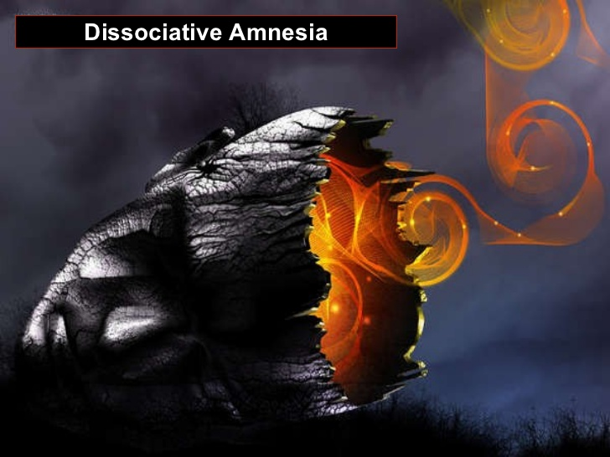

Slide 13
DISSOCIATIVE AMNESIA
Dissociative amnesia is when a person can’t remember the details of a traumatic or successful event, although they do realise they are experiencing memory loss. This is also known as psychogenic amnesia. This type of amnesia can last from a few days to one or more years. Dissociative amnesia may be linked to other disorders such as an anxiety disorder.

Slide 14
Risk factor is psychological stress
More common in women and young adults
Onset is usually detected retrospectively by discovery of memory gaps of extremely variable duration
The amnesia may suddenly or gradually remit, particularly when the traumatic circumstance resolves, or may become chronic.
It is associated with mood disorders, conversion disorder, and personality disorders
Differential diagnosis: amnestic disorder due to a general medical condition, substance-induced amnestic disorder, and other dissociative disorders.

Slide 15
The categories of dissociative amnesia include:
Localised amnesia: for a time, the person has no memory of the traumatic event at all. For example, following an assault, a person with localised amnesia may not recall any details for a few days.
Selective amnesia: the person has patchy or incomplete memories of the traumatic event.
Generalised amnesia: the person has trouble remembering the details of their entire life.
Systematised amnesia: the person may have a very particular and specific memory loss; for example, they may have no recollection of one relative.
Continuous amnesia: occurs when patients have no memory of events up to and including the present time. This means that patients are alert and aware of their surroundings but are not able to remember anything.

Slide 16
Dagnosis and DSM-IV Criteria
At least one episode of inability to recall important personal information, usually involving a traumatic or stressful event
The amnesia cannot be explained by ordinary forgefulness
Symptoms cause significant distress or impairment in daily functioning and cannot be explained by another disorder, including traumatic brain injury, medical condition, or substance use.

Slide 17
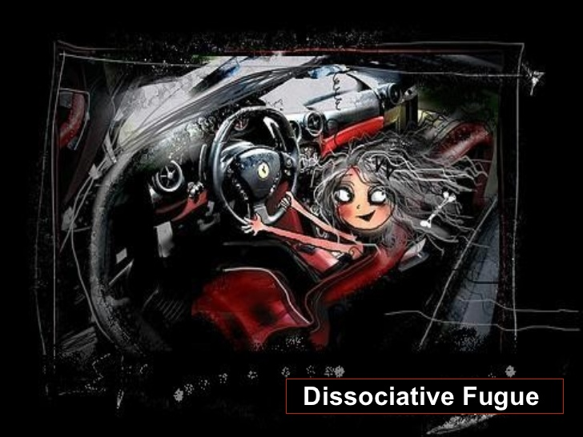

Slide 18
DISSOCIATIVE FUGUE
Dissociative fugue is also known as psychogenic fugue. The person suddenly, and without any warning, can’t remember who they are and has no memory of their past. They don’t realise they are experiencing memory loss and may invent a new identity. Typically, the person travels from home – sometimes over thousands of kilometers – while in the fugue, which may last between hours and months. When the person comes out of their dissociative fugue, they are usually confused with no recollection of the ‘new life’ they have made for themselves.

Slide 19
Dissociative fugue
Is characterized by sudden, unexpect travel away from home, accompanied by the inability to recall one’s identity or one’s past.
Patients may asume an enterily new identity and occupation after arriving in the new location.
They are unaware of their amnesia and new identity, and they never recall the period of the fugue.
Patients show characteristically low anxiety despite their confusión. Their affect is similar to “La belle indifference” of conversión responses

Slide 20
Diagnosis and DSM.IV Criteria
Sudden, unexpect travel away from home or work plus inability to recall one’s past.
Confusionabout personal identity or asumption of new identity
Not due to dissociative identity disorder or the physiological effects of a substance or medical disorder
Symptoms cause impairment in social or occupational functioning

Slide 21
Tratment for dissociative amnesia and dissociative fugue.-
Safety
Psychotherapy
Hypnosis
Psychiatric drugs if neccesary

Slide 22
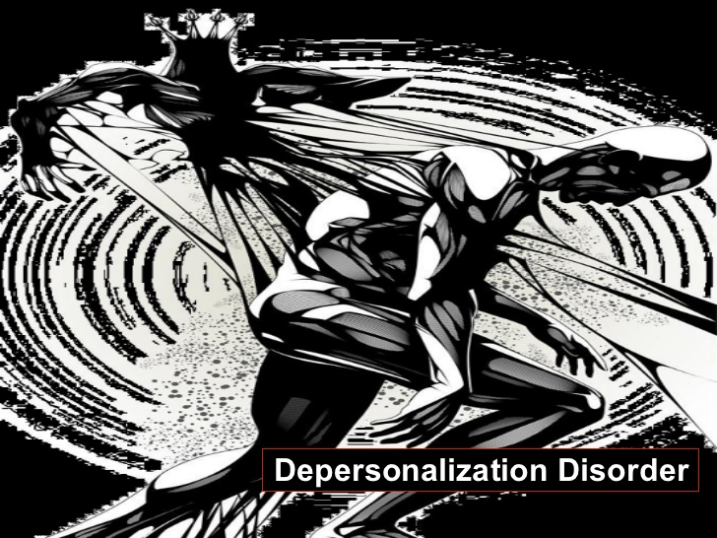

Slide 23
DEPERSONALISATION DISORDER
A dissociative disorder in which the sufferer is affected by persistent or recurrent feelings of depersonalisation and/or derealisation.
Brought by overwhelming feelings about a current event similar to a past traumatic event
The onset is rapid
The symptoms include a sense of automation, going through the motions of life but not experiencing it, feeling as thought one is in a dream, feeling a disconnection from one’s body, out-of-body experience, a detachment from one’s body, environment and difficulty relating oneself to reality.

Slide 24
For all, it is a rather disturbing illness, since many feel that indeed, they are living in a dream.
They feel separated from themselves or outside their own bodies.
People with this disorder feel like they are going crazy and they frequently become anxious and depressed.

Slide 25
Risk factor is psychological stress
Episodes of depersonalization are common
Usually in adolescence or early adulthood. Stressful events may precede the onset of the disorder.
Treatment is psychotherapy directed at decreasing anxiety
Major rule-outs are substance-induced mental disorders with dissociative symptoms, including intoxication, withdrawal, hallucinogen-induced persisting perceptual disorder, panic disorder, and PTSD.

Slide 26
Diagnosis and DSM-IV Criteria
Persistent or recurrent experiences of being detached from one’s body or mental processes.
Reality testing remains intact during episode
Causes social / occupational impairment, and cannot be accounted for by another mental or physical disorder.

Slide 27
Epidemiology.-
Twice as common in women
More common among adolescents / Young adults
Frequently comorbid with anxiety disorders and major depression.
Severe stress is a predisposing factor
Treatment.-
Antianxiety agents or SSRI to treat associated symptoms of anxiety or major depression.

Slide 28
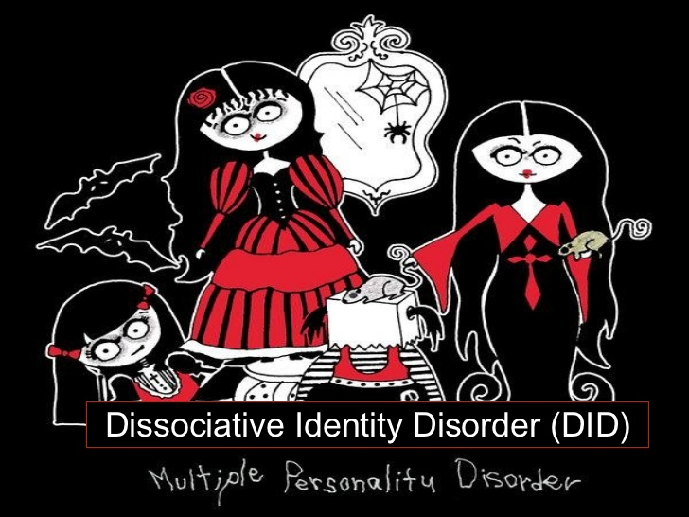

Slide 29
DISSOCIATIVE IDENTITY DISORDER
Dissociative identity disorder is the most controversial of the dissociative disorders and is disputed and debated among mental health professionals. Previously called multiple personality disorder, this is the most severe kind of dissociative disorder.
It is characterised by switching to alterate identities when under stress.
Caused by severe childhood trauma and severe sexual abuse
More common in women

Slide 30
the onset is insidious
A dissociative disorder involving a disturbance of identity in which two or more separate and distinct personality states (or identities) control the individual’s behavior at different times. When under the control of one identity, the person is usually unable to remember some of the events that occurred while other personalities were in control.
The different identities, referred to as alters, may exhibit differences in speech, mannerism, attitudes, thoughts, and gender orientation.
The alters may even differ in “physical” properties such as allergies, right-or-left handedness, or the need for eyeglass prescriptions. These differences between alters are often quite striking.
The person with DID may have as few as two alters, or as many as 100. the average number is about 10

Slide 31
Comorbidity: borderline personality disorder, PTSD, major depression disorder and other mood disorders, substance-related disorders, sexual disorders, and eating disorders.
Symptoms may fluctuate or be continuous
Differential diagnosis: borderline personality disorder and other personality disorders, bipolar disorder with rapid cycling, factitious disorder, and malingering.
Psychotherapy to uncover psychologically traumatic memories and to resolve the associated emotional conflict

Slide 32
Diagnosis and DSM- Criteria
Presence of two or more distinct identities.
At least two of the identities recurrently take control of the person’s behaviour.
Inability to recall personal information of one personality when the other is dominant
Not due to effects of substance or medical condition.

Slide 33
Epidemiology.-
90 % of patients are women
Most patients have experience prior trauma, especially childhood physical or sexual abuse,
Average age of onset is 6. The average age of diagnosis is 30.
High incidence of comorbid with major depression, anxiety disorders, borderline personality disorder and substance abuse.
Up to one-third of patients attempt suicide.

Slide 34
COMPLICATIONS OF DD
Without treatment, possible complications for a person with a dissociative disorder may include:
Life difficulties such as broken relationships and job loss
Sleep problems such as insomnia
Sexual problems
Severe depression
Anxiety disorders
Eating disorders such as anorexia or bulimia
Problematic drug use including alcoholism
Self-harm, including suicide.

Slide 35
TREATMENT
The effectiveness of treatments for dissociative disorders has not been studied. Treatment options are based on case studies, not research. Generally speaking, treatment may take many years. Options may include:
A safe environment: doctors will try to get the person to feel safe and relaxed, which is enough to trigger memory recall in some people with dissociative disorders.
Psychiatric drugs: such as barbiturates.
Hypnosis: may help to recover repressed memories, although this form of treatment for dissociative disorders is considered controversial.

Slide 36
Psychotherapy: also known as ‘talk therapy’ or counselling, which is usually needed for the long term. Examples include cognitive therapy and psychoanalysis.
Stress management: since stress can trigger symptoms.
Treatment for other disorders: typically, a person with a dissociative disorder may have other mental health problems such as depression or anxiety. Treatment may include antidepressants or antianxiety medications to try to improve the symptoms of the dissociative disorder.

Slide 37
Dissociative disorder no otherwise specified.-
Primary dissociative disorder that share the characteristics of disruption in consciousness, memory, identity or perception but do not meet the criteria of the other specific categories are included in this category. Many of these disorders include cultual components and are very unlikely to be seen in the wards.

Slide 38
DIFFERENTIAL DIAGNOSIS
Ordinary forgetfulness and non pathological amnesia
Dementia, delirium, and organic amnestic disorders
Posttraumatic amnesia
Seizure disorders
Substance-related amnesia
Transient global amnesia
Acute stress disorder, posttraumatic stress disorder, and somatoform disorders
Malingering and factitious amnesia

Slide 39
THANKS

